Slide 1
Cognitive correlates of First-Person Shooter gaming: A cross-sectional study of Counter-Strike players
Eleanor R. A. Hyde, Robert Schmidt, Daniel J. Carroll and Claudia C. von Bastian
31/10/2024
ERNC 2024

Slide 2




Cognition: mental processes
Cognitive Correlates
Cognitive Plasticity

Slide 3

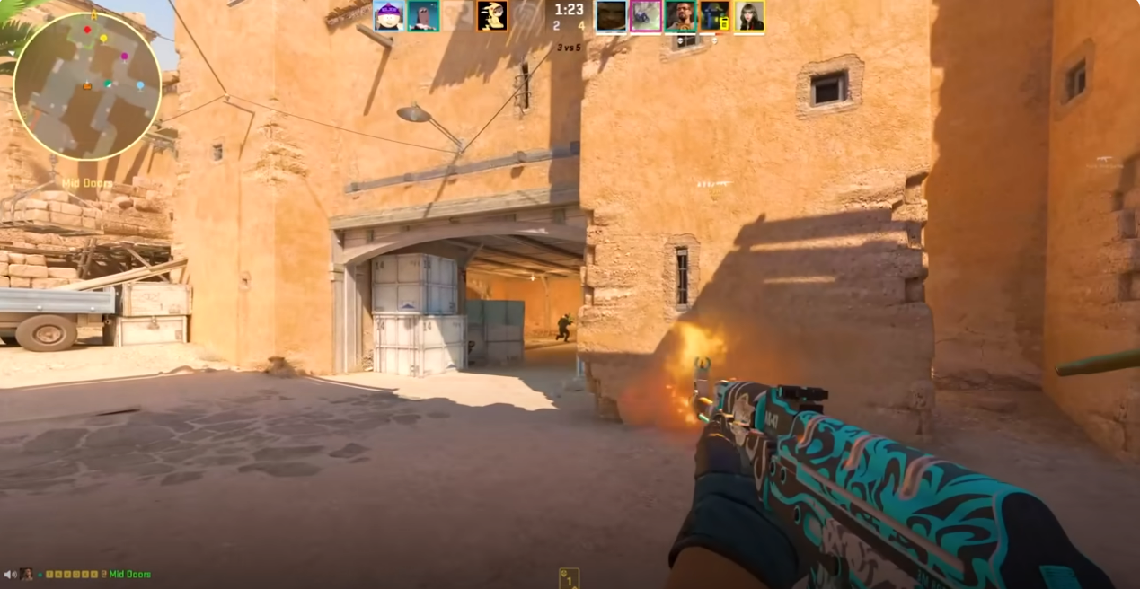


Leisure Activities
Engagement in cognitively challenging leisure activities may relate to cognitive performance – with the potential for cognitive plasticity (von Bastian, Hyde & Jiang, 2023)

Slide 4



Previous Methodological Limitations
Research shows mixed findings for the cognitive correlates of FPS gameplay:
Broad definitions of video games
Small samples of novice players
Limited assessment of video game skill
Counter-Strike

Slide 5


Method: Counter-Strike Skill
Total hours playtime
Weekly hours playtime
Self-rated skill
Current ranking (CS:GO)
K-means cluster analysis

Slide 6
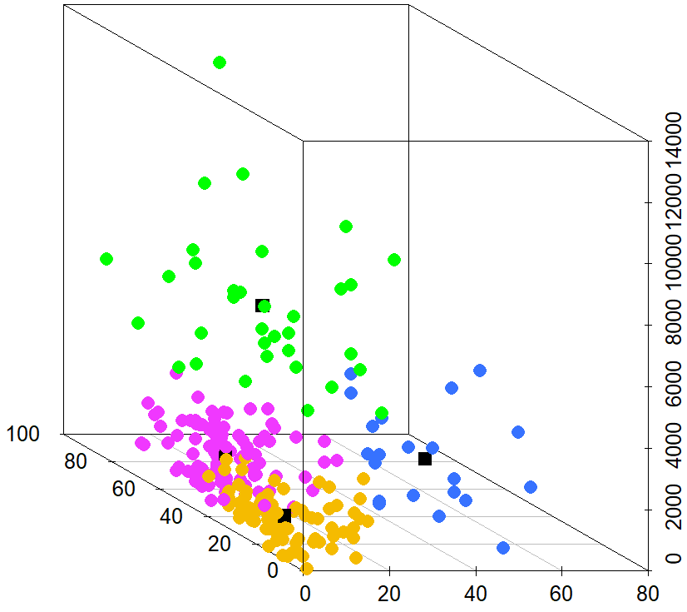
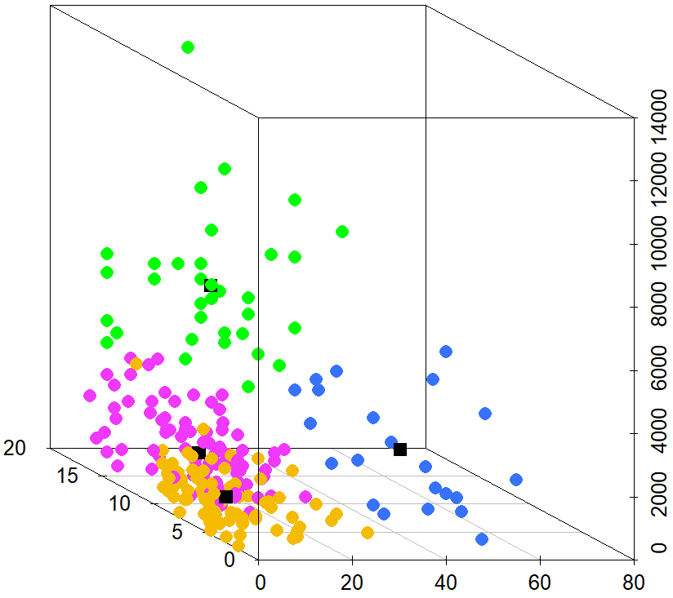
Method: Counter-Strike Skill
Semi/Professional (n = 34) | Experienced (n = 101)
Aspiring (n = 22) | Novice (n = 78)
Total Hours
Total Hours
Self-Rated Skill
Current Ranking
Weekly Hours
Weekly Hours

Slide 7



Method: Cognitive Task
Choice Reaction Time Task
Blue or Green
Curvy or Spiky

Slide 8
Measures
Single Task: general processing speed ability
Mixing Tasks: ability to conduct two or more tasks in close succession
Switching Tasks: ability to switch from one task to another

Slide 9
Processing Speed
Differences in single task and switching tasks processing speed
M = 591, SD = 112

Slide 10

The Drift-Diffusion Model
1. Drift Rate (v) information accumulation
2. Boundary Separation (a) response caution
3. Non-decision time (t0) other non-decisional processes
Drift Rate (v)
Boundary Separation (a)
Green
Blue
Encoding
Decision Time
Response Execution
Non-decision time (t0)

Slide 11
The Drift-Diffusion Model
Differences in single task boundary separation and non-decision time
M = 591, SD = 112

Slide 12
The Drift-Diffusion Model
Differences in switching tasks drift rates
M = 591, SD = 112

Slide 13
Take-home message
Greater FPS skill relates to faster processing speed, but performance advantages go beyond simple button pressing.
Greater efficiency in speeded decision-making, especially in situations which require greater cognitive flexibility (von Bastian et al., 2022).
Video gaming is a potential avenue for cognitive plasticity in decision-making.

Slide 14





Thank you! ww.eleanorhyde.com erahyde1@sheffield.ac.uk
Supervisory Team
Claudia
von Bastian
Dan Carroll
Robert Schmidt

